Slide 1
Digital Portfolio
STUDENT NAME: ANBAZHAGAN.S
REGISTER NO AND NMID: 20124U09001,20120124U09001
DEPARTMENT: BCA
COLLEGE: ARIGNAR ANNA GOVT ARTS COLLEGE/THIRUVALLUVAR UNIVERSITY

Slide 2
STUDENT DIGITAL PORTFOLIO

Slide 3


AGENDA
Problem Statement
Project Overview
End Users
Tools and Technologies
Portfolio design and Layout
Features and Functionality
Results and Screenshots
Conclusion
Github Link
3/21/2024 Annual Review

Slide 4

PROBLEM STATEMENT
Traditional resumes are static and text-based. They do not effectively showcase a student’s technical skills, projects, and creativity in an interactive way.There is a need for a dynamic, user-friendly portfolio website that highlights a student’s personal details, academic background, projects, and achievements with modern web technologies.

Slide 5

PROJECT OVERVIEW
This project focuses on developing a Digital Portfolio Website that represents a student’s professional and academic profile.The portfolio contains sections like About Me, Projects, Skills, Resume, and Contact.Using JavaScript, the portfolio includes interactive features like a typing effect, dark mode, form validation, and project image slideshows, making it engaging and attractive

Slide 6

WHO ARE THE END USERS?
Students → To showcase their skills and projects for placement.
Recruiters / Employers → To evaluate a candidate’s technical profile.
Teachers / Mentors → To track and review student projects.
General Audience → Anyone interested in learning more about the student.

Slide 7

TOOLS AND TECHNIQUES
HTML5 → Structure of the website
CSS3 → Styling and layout design
JavaScript (ES6) → Interactivity and functionality
GitHub Pages → Hosting the website online
VS Code → Code editor
Browser DevTools → Debugging and testing

Slide 8
POTFOLIO DESIGN AND LAYOUT
Header / Navbar → Navigation links (Home,
About, Projects, Contact)
Home Section → Introduction with typing
Effect
About Section → Academic details, skills, and
interests
Projects Section → Showcasing projects with
screenshots and descriptions
Resume Section → Download CV button
Contact Section → Form with validation
(Name, Email, Message)
Footer → Social media and GitHub links
8

Slide 9
FEATURES AND FUNCTIONALITY
✅ Responsive Design – Works on mobile,
tablet, and desktop
✅ Typing Effect – Dynamic intro text using
JavaScript
✅ Dark Mode Toggle – Switch between light/
dark themes
✅ Form Validation – Ensures proper input in
contact form
✅ Image Slideshow – Displays project
Screenshots
✅ Smooth Navigation – Scrolls smoothly to
each section
✅ GitHub Integration – Direct link to source
code

Slide 10

RESULTS AND SCREENSHOTS
Successfully created a fully responsive portfolio website using HTML, CSS, and JavaScript.Interactive UI features improved user experience.Website was deployed on GitHub Pages for public access.(Here you can add screenshots of Home Page, About Page, Projects Page, Contact Page
3/21/2024 Annual Review
10

Slide 11
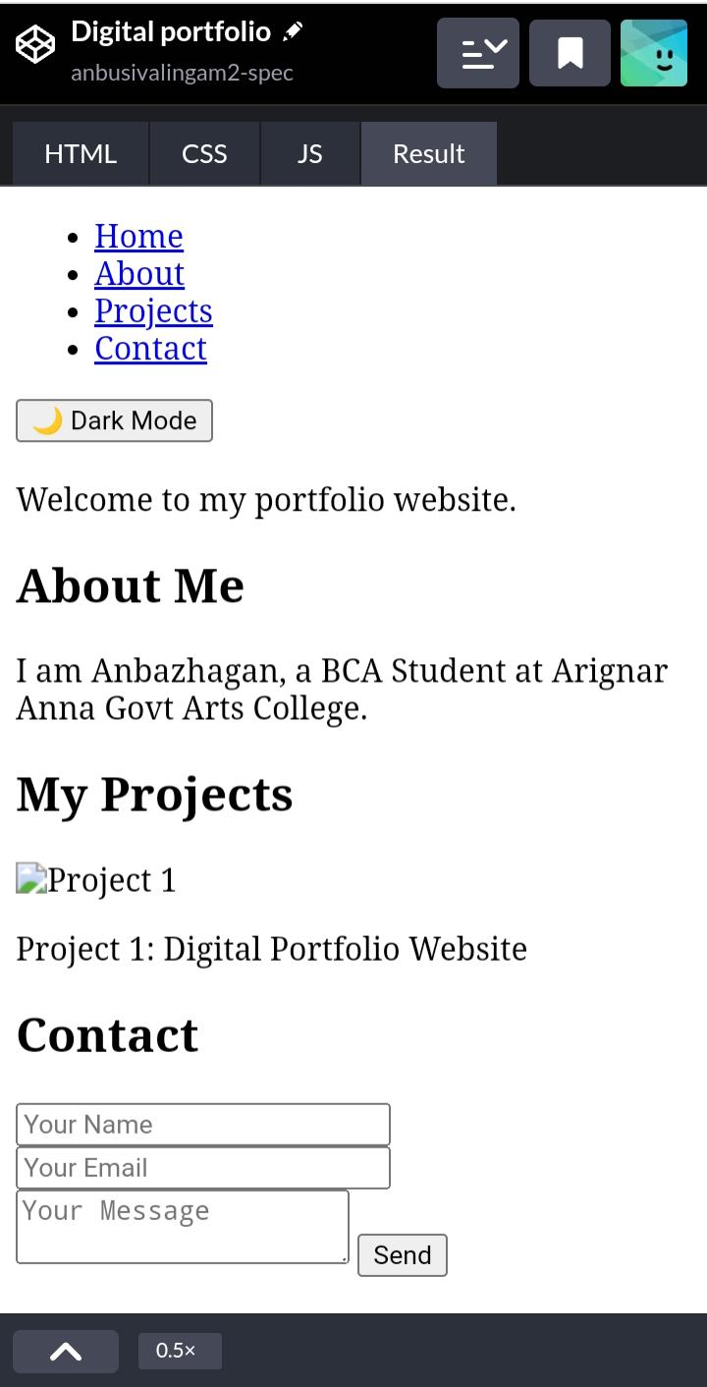
BEFORE:

Slide 12
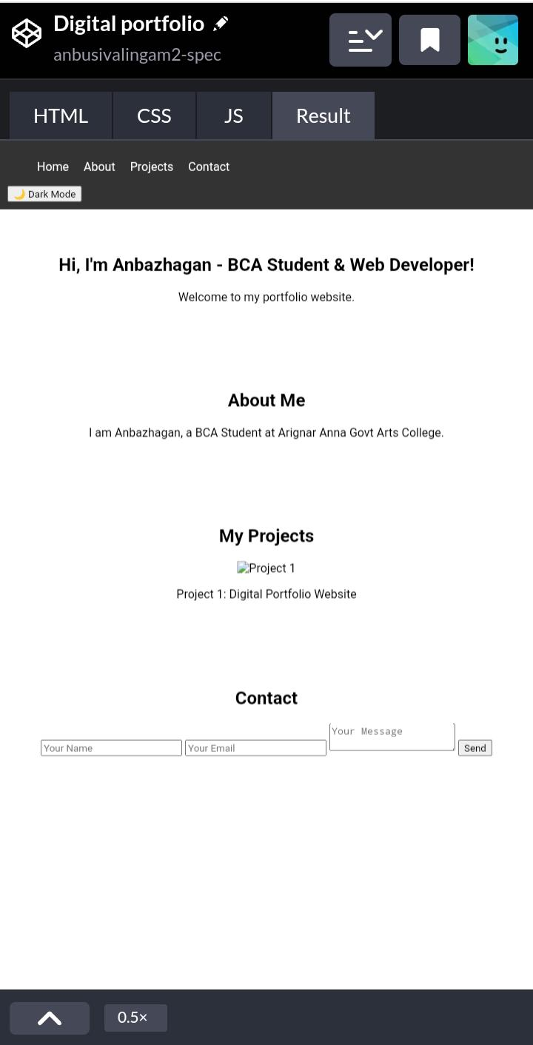
AFTER:

Slide 13
CONCLUSION
The Digital Portfolio Website effectively demonstrates how a student’s academic and technical details can be showcased online in an interactive manner.By using JavaScript, the website becomes dynamic and user-friendly.This project enhances skills in frontend development (HTML, CSS, JavaScript) and serves as a foundation for advanced projects
13

